Slide 1
CIS 545 Final Project - Software Detect Prediction
Haoyi Cheng, Yinuo Xie, Chenkang Zhang

Slide 2
Agenda
Project Objective
Dataset Overview
Exploratory Data Analysis
Model Selections & Evaluation Metrics
Data Preprocessing & Hyperparameter Tuning
Data Augmentation
Model Performance Comparison
Conclusion

Slide 3
Project Objective
Goal: Develop a classification model capable of predicting the presence of defects in a C program
Benefits:
Proactively identify potential defects
Reduce debugging time
Improve overall code quality
We hope that the outcome of this project would augment the code development process, making it a valuable endeavor in the realm of software engineering.
Notes:
The objective of this project is to create a classification model capable of predicting the presence of defects in a C program, utilizing various features of the program as indicators. We are aiming to enhance the functionality of Integrated Development Environments (IDEs) by providing users with a tool that can proactively identify potential defects, thereby promoting code accuracy and reducing debugging time. We hope that the outcome of this project would augment the code development process, making it a valuable endeavor in the realm of software engineering.

Slide 4
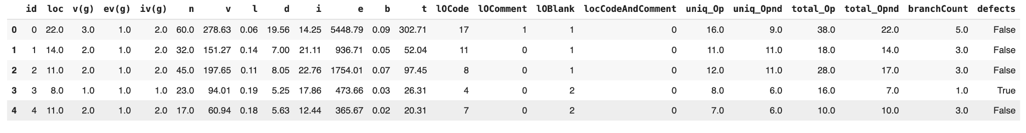
Dataset Overview: Understanding Our Data
Dataset: Binary Classification with a Software Defects Dataset available on Kaggle. It is a synthetic dataset generated from a deep learning model that was trained on the original Software Defect Dataset released on December 2, 2004.
Content:
Each row in the dataset represents a C program
22 input features describe various metrics and characteristics of these programs and one target variable defects

Slide 5
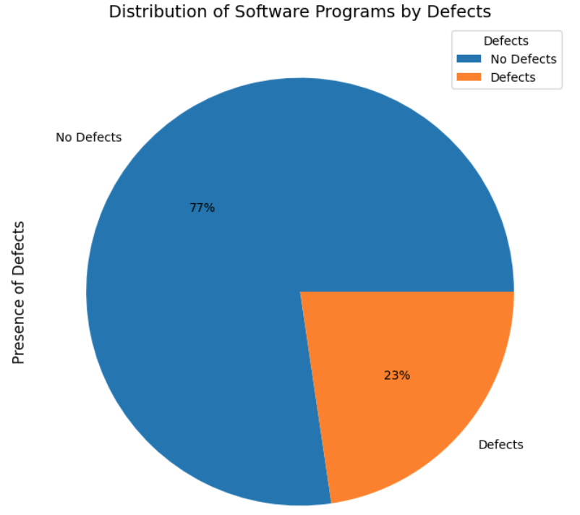
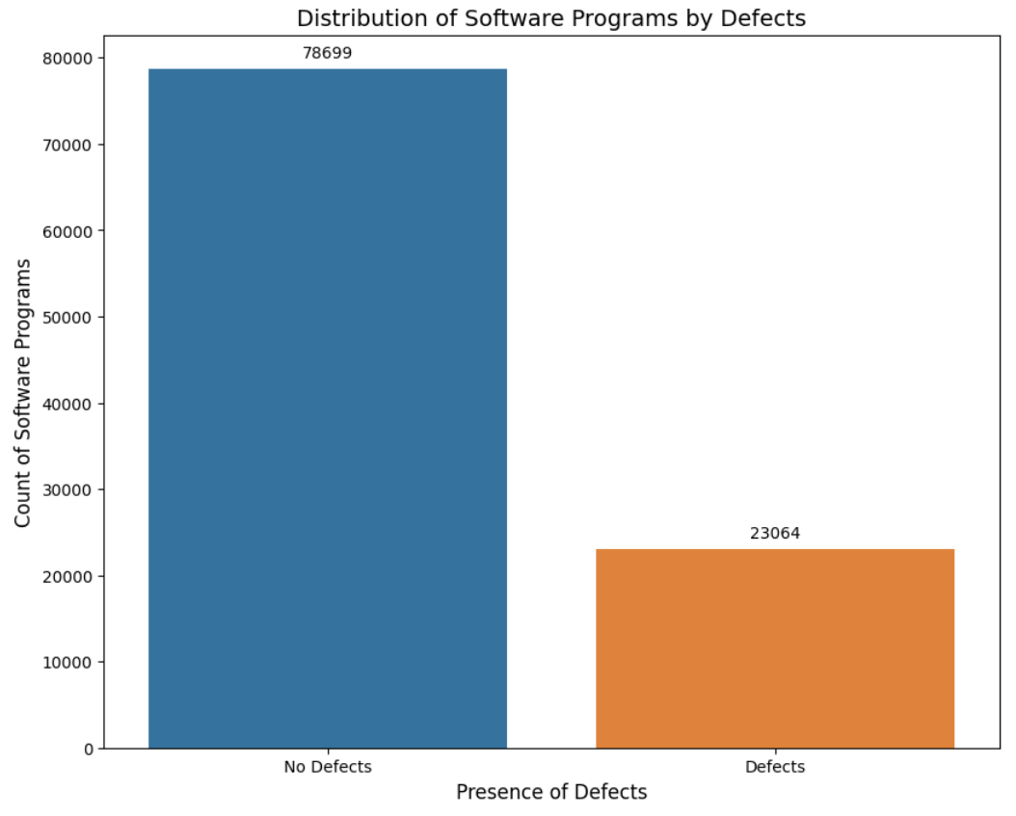
EDA - Distribution of Defects
Notes:
First let’s observe the distribution of target variable defects. From both histogram and pie chart plots, we see that our dataset is highly imbalanced.

Slide 6
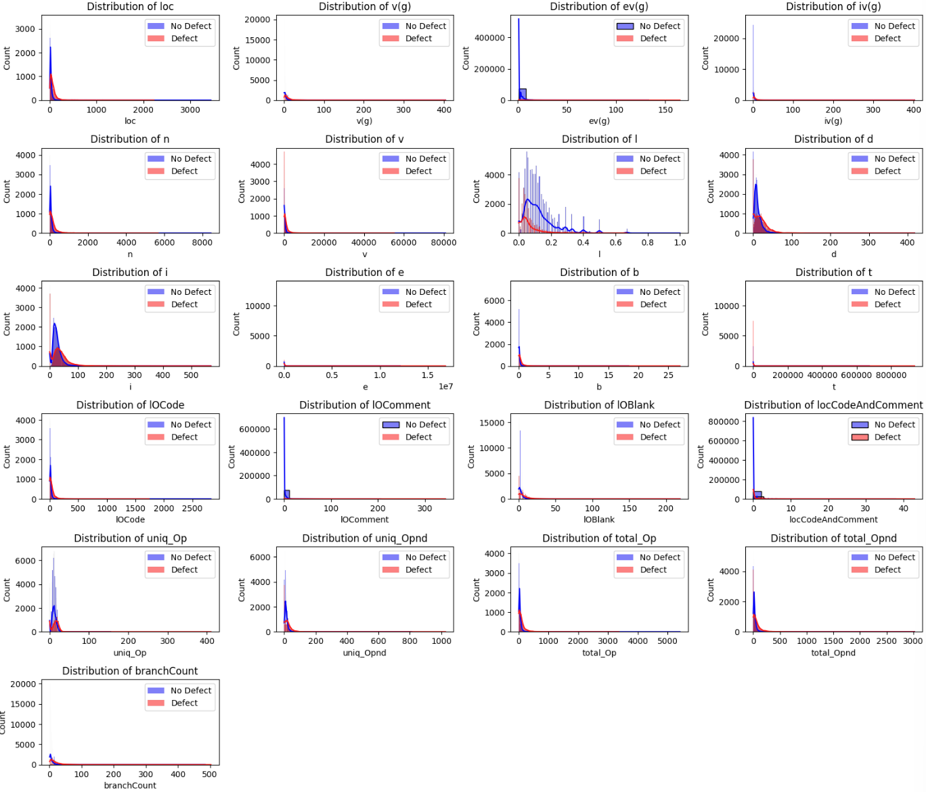
EDA - Distribution of Features
Input features are in different scales.
There are many outliers data present in each features.
Notes:
Then let’s observe the distribution of input features excluding id.
These outliers, represented as thin and short bins that significantly deviating from the majority of the distribution. However, this outliers data might be interpreted as for some programs, they contain significantly longer codes and comments compared to other programs

Slide 7
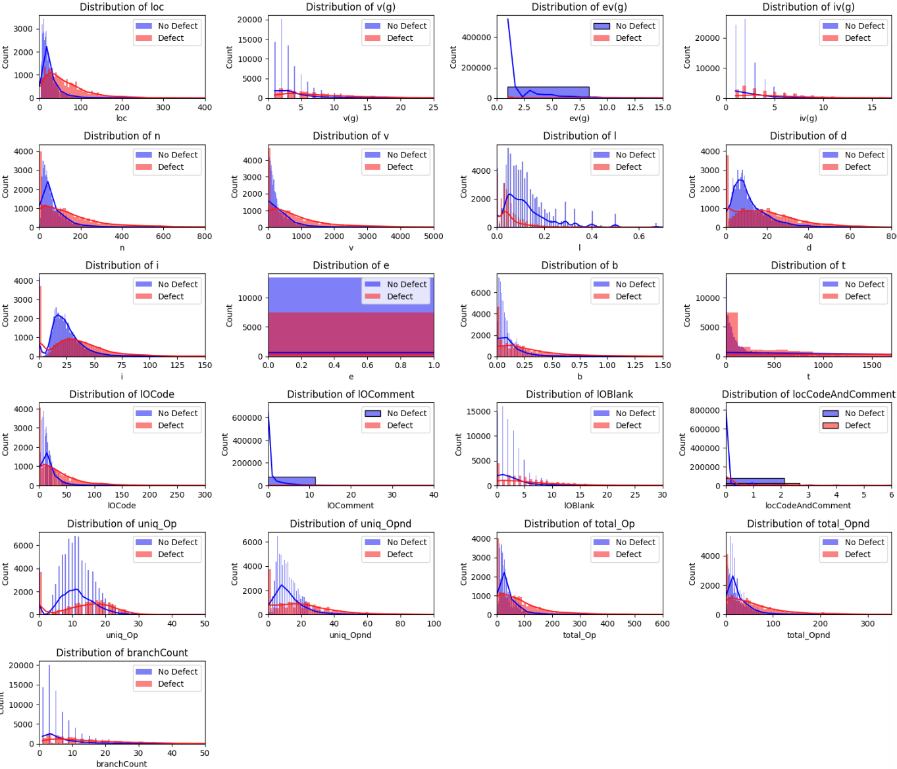
EDA - Distribution of Features
All 21 features' histograms lean towards lower values with some high outliers.
Program marked as “Defect” tend to have higher values in their features.
Programs labeled “No Defect” generally show lower feature values.
Notes:
a distinct trend wherein programs labeled as "Defect" exhibit larger values for their associated features compared to programs labeled as "No Defect."

Slide 8
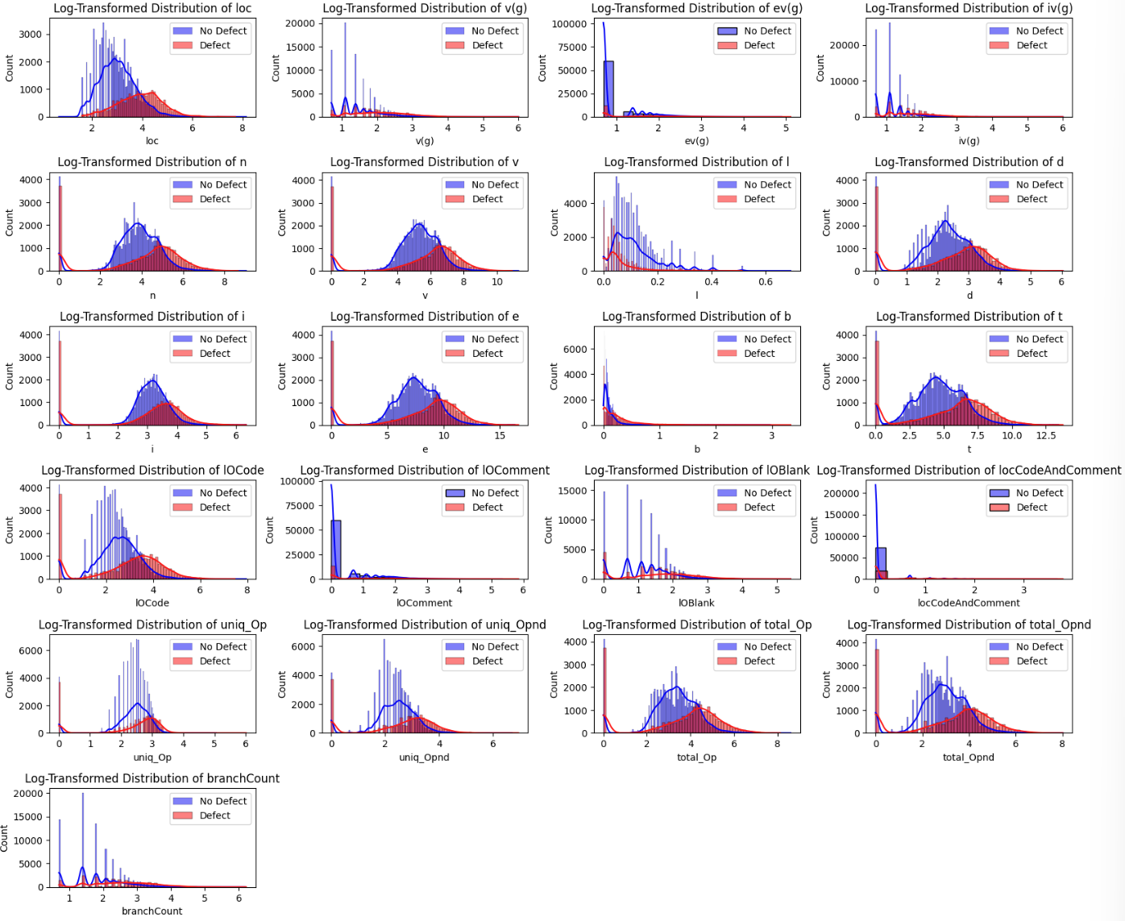
EDA - Log-Transformed Distribution of Features
Our histograms again show us "Defect" program exhibit larger values for their associated features compared to programs labeled as "No Defect."

Slide 9
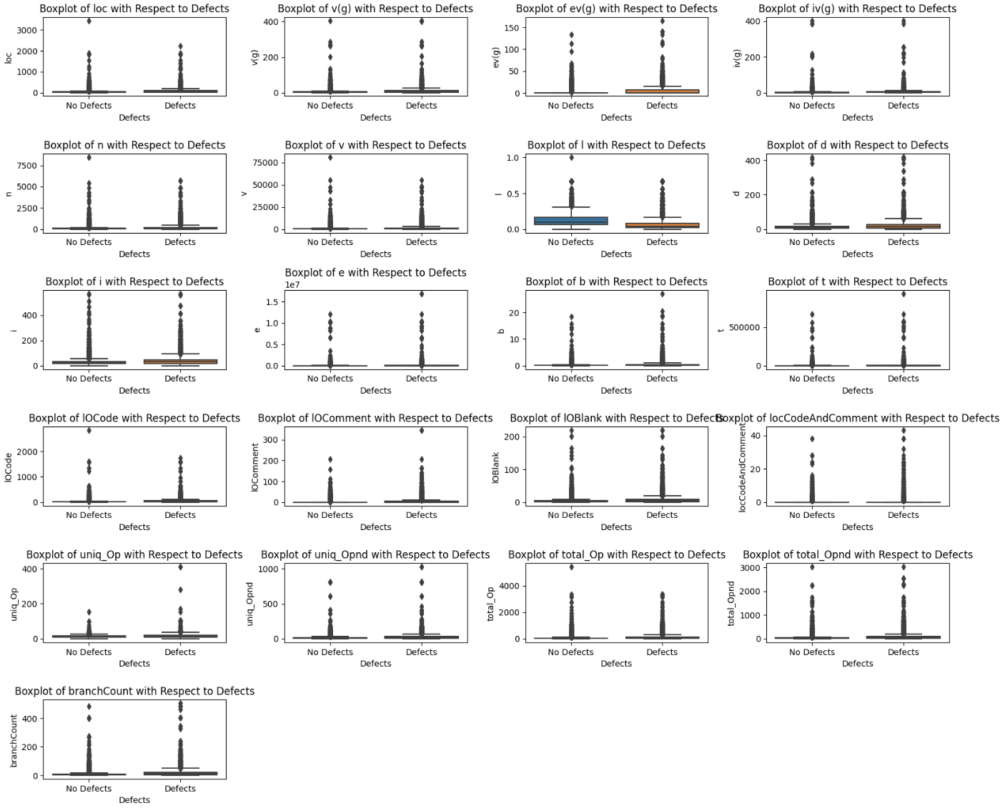
EDA - Box Plot of Features
Outliers tend to be more common in “defect” programs
Notes:
Based on the boxplots of 21 input features, we can clearly observe that the features are widely spread. Just as what we observed from the histograms, theses features contain many outliers data as present by data points in the boxplot. While one more findings compared to what we see from histograms is that outliers data tend to more common in "defect" programs, and the corresponding value of these outliers also tend to be larger compared to defect-free programs. Moreover, the boxplots again indicate that "Defect" program exhibit larger values for their associated features compared to programs labeled as "No Defect."

Slide 10
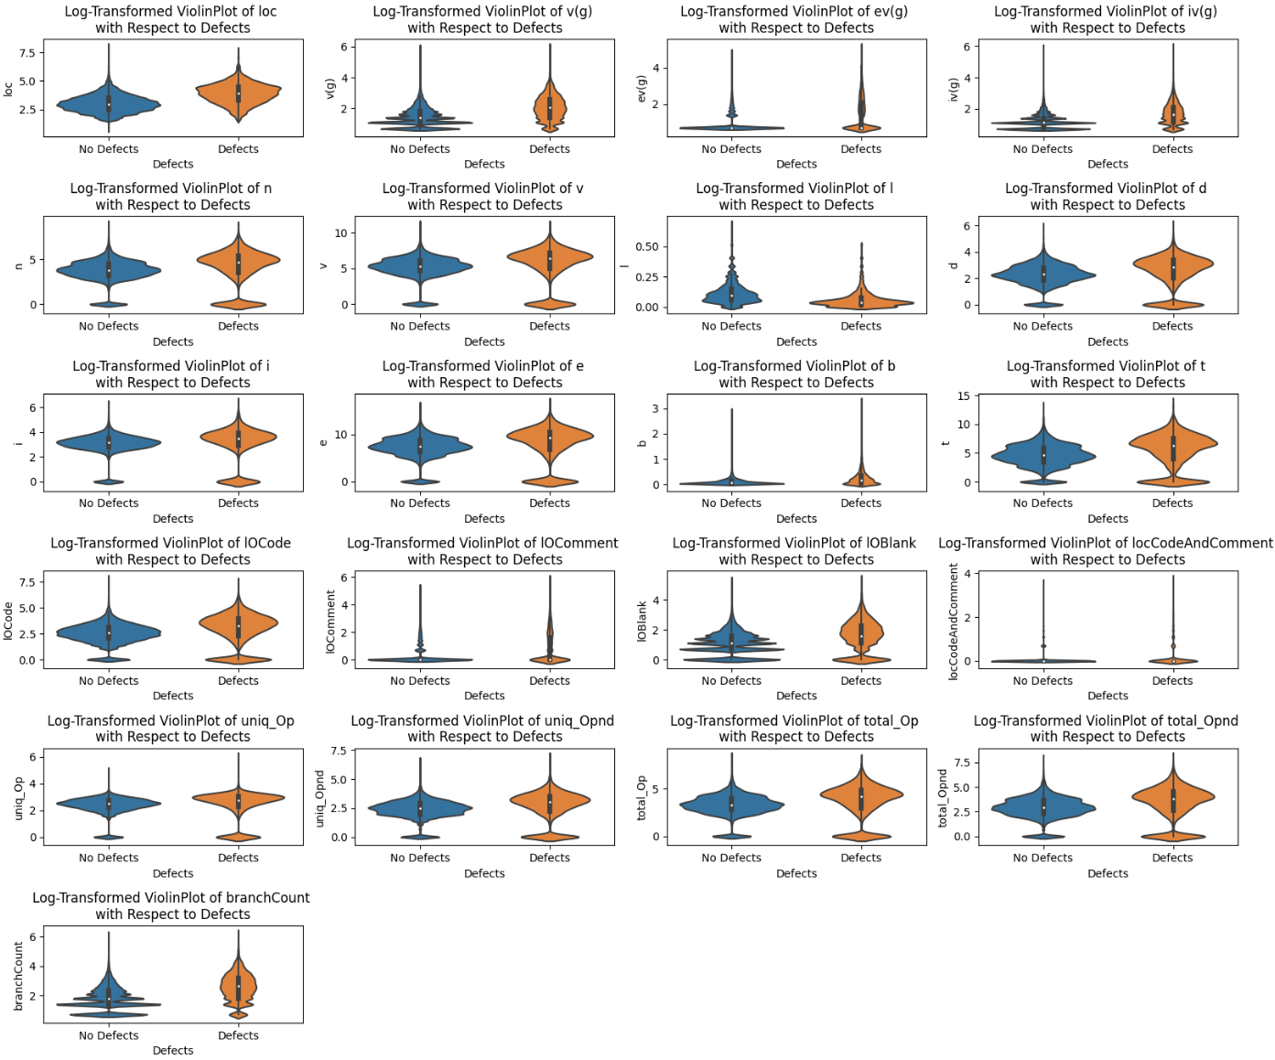
EDA - Log-Transformed Violin Plots
In "No Defect" programs, outliers are more concentrated around lower values, indicating simpler code structures.
Notes:
Again, similar trends can be also observed in these log-transformed violin plots. The larger feature values in the "Defect" category compared to "No Defect" category highlights the importance of considering code complexity and comprehensibility in the context of software quality assurance. Some new findings from these violin plots is that in terms of outlier concentration, we see that "No Defects' programs tend to be more concentrated around the lower whisker. This indicates that defect-free program often have simpler and more straightforward code structures. However, this might be explained by the nature of this unbalanced dataset where "No Defects" data are more common, leading to its more concentrated character.

Slide 11
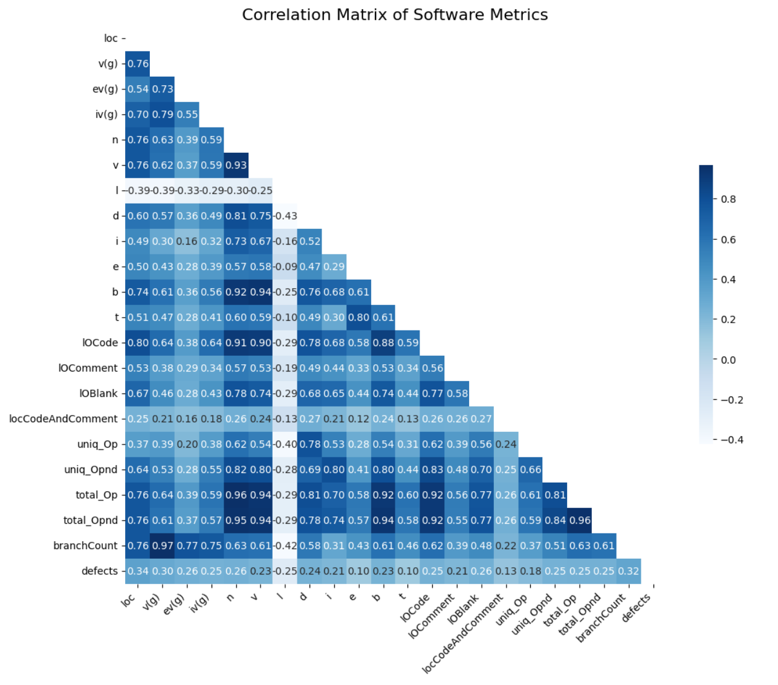
EDA - Correlation Matrix
Moderate Correlation: Input features and defect presence not strongly correlated.
Key Insights:
Higher Correlation: Complexity indicators (loc, v(g), branchCount) align with defects.
Lower Correlation: Effort and time (e, t) less predictive of defects.
Unexpected: Program length (l) weakly negative with defects, suggesting longer code might be less prone to errors.
Notes:
The observed correlation between the input features and the defects variable does not appear to be very strong.
The features, loc (McCabe's line count of code), v(g) (McCabe's cyclomatic complexity), and branchCount (percentage of the flow graph) are relatively highly correlated with defects variable. These correlation makes sense as from the above EDAs, we have already observed that the degree of complexity, sophistication, or completeness of programs distinguish defect programs from defect-free programs.
The features, e (Halstead "effort") are t (Halstead time estimator) are relatively weakly correlated with defects variable. These correlations also make sense in the context of real-world, as individual efforts and time put into writing the program are less likely to affect the characteristics and quality of code. Individual efforts and time put into writing the program might be confounding variable, as they are differ from programmers' coding ability perspective.
The feature, l (Halstead "program length"), is negatively correlated with the defects variable. This somehow contradicts our finding from the above EDAs, in which it implies that longer program lengths may contribute to more robust and error-resistant software. But with this new findings, we can further refine our hypothesis. The increased complexity might result in a higher likelihood of introducing errors or bugs, but longer program lengths still support the notion that complete, comprehensive, and well-structured codebases are less prone to defects. This understanding invites further investigation into the intricate dynamics between program length, complexity, and software robustness, which will be discussed later in this project. The feature, l (Halstead "program length"), tend to show a relatively weak negative correlation with all other features. This might suggest the less usefulness of this feature. However, as we discussed above, the negative correlation with defects variable might still indicate that this character can guide our decision-making processes in the context of software quality assessment.
Note that, there are some highly correlated input features, which are branchCount & v(g), total_Opnd & n, total_Opnd & v, total_Opnd & b, total_Op & n, total_Op & v, total_Op & b, total_Op & total_Opnd, n & v, b & v. These correlations might indicate shared patterns or characteristics that co-occur within the software programs. We want to further analyze these correlations within the following EDA section.

Slide 12
Dataset EDA Summary
Feature Distribution:
Right-skewed features, indicating lower values with some high outliers.
"Defect" programs generally have higher feature values than "No Defect" programs.
Data Characteristics:
Outliers more concentrated in "No Defect" programs, suggesting simpler code structures.
Data imbalance may influence observed patterns.
Correlation Analysis:
Moderate overall correlation between features and defect presence.
Complexity metrics (loc, v(g), branchCount) show higher correlation with defects.
Effort and time (e, t) less linked to defects.
Program length (l) negatively correlated with defects, indicating longer code might be less error-prone.

Slide 13
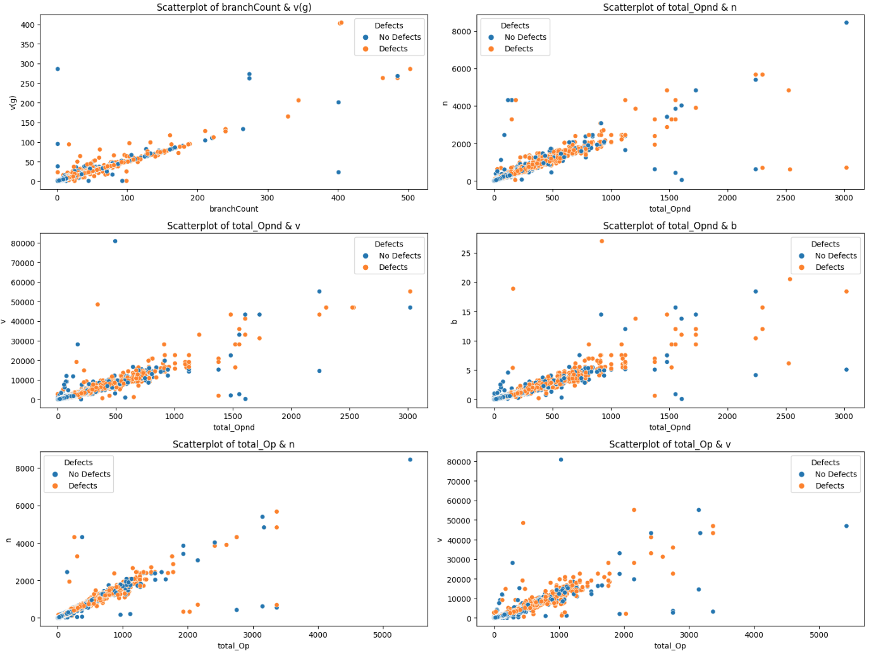
EDA - Highly Correlated Features

Slide 14
Predictive Models for Defect Detection
Model Selection Overview:
Logistic Regression: Basic yet effective for binary classification.
Random Forest: Uses multiple decision trees for greater accuracy.
Gradient Tree Boosting & XGBoost: Advanced models focusing on performance and error correction.
Customized Deep Learning Model: Tailored to capture complex patterns in our specific dataset.
Why This Mix?:
Offers a range from basic to advanced analysis.
Ensures robustness through diverse approaches.
Combines traditional and cutting-edge techniques for optimal prediction.
Goal: To accurately predict software defects, leveraging each model's unique strengths.
Notes:
Now let’s move on to explore predictive models for defect detection in software. Starting with Logistic Regression, our baseline model, known for its simplicity and effectiveness in binary classification.
We then progress to more complex models like the Random Forest, which handles non-linear relationships and mitigates overfitting, and Gradient Tree Boosting, focusing on correcting errors iteratively. Additionally, we implement the XGBoost Classifier, known for its efficiency, and finally, a Feed-Forward Neural Network, which we anticipate will excel in capturing intricate patterns within our dataset.

Slide 15
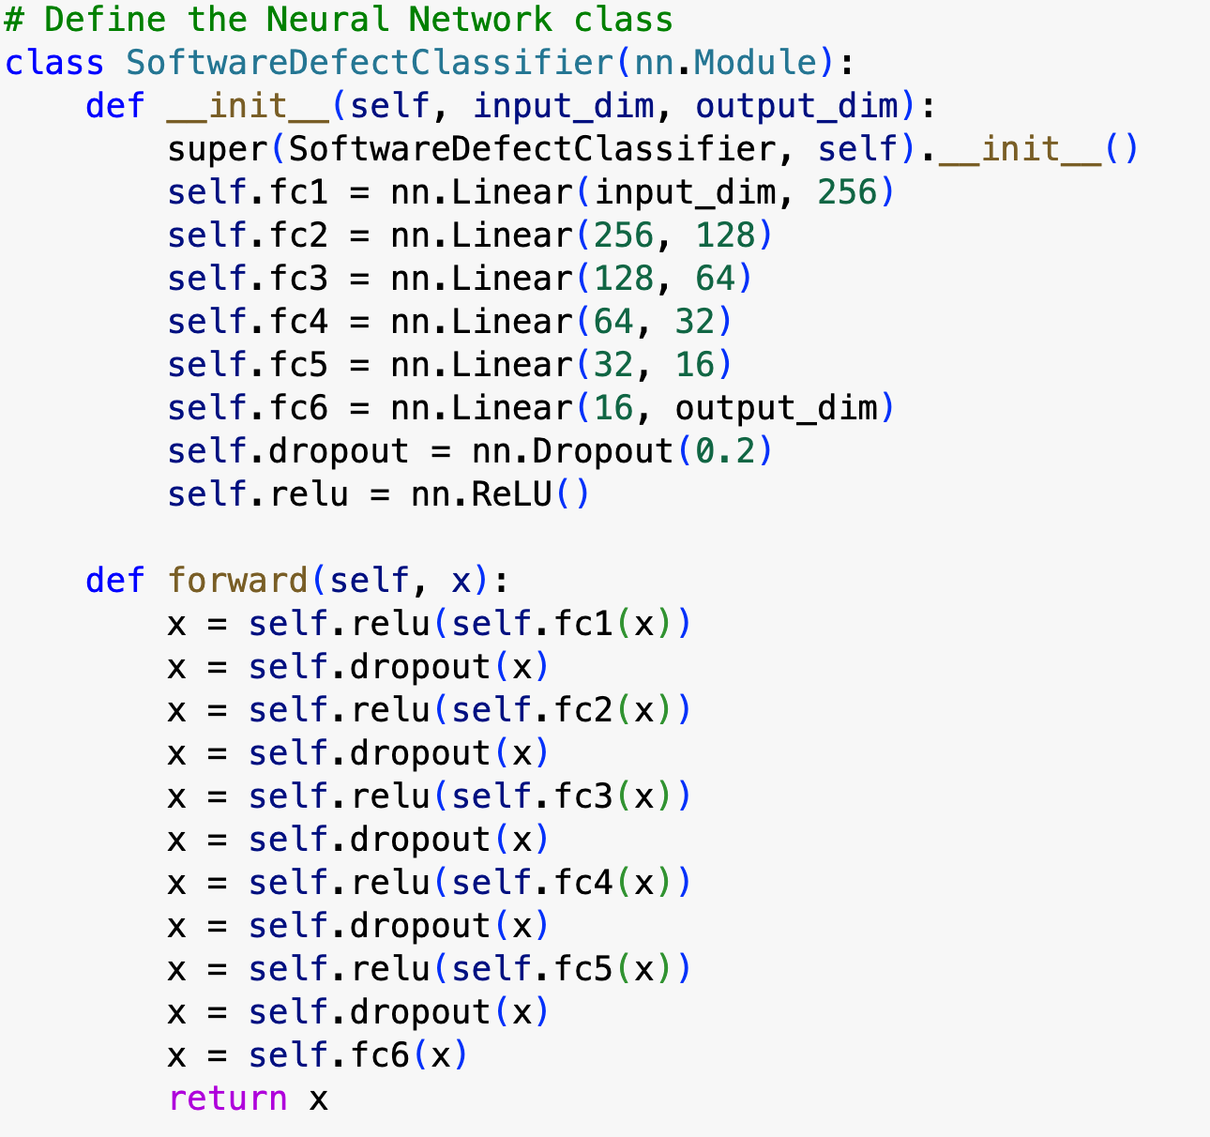
Modeling - Feedforward Neural Network
Beyond Traditional ML:
Neural networks excel in learning layered feature representations, unlike traditional machine learning algorithms.
Key Features:
Hierarchical Learning: Can capture complex structures in data through layers.
Non-Linear Activation & Hidden Layers: These enable the model to learn more intricate relationships within the data.
Why It Matters:
Offers a more sophisticated approach to tackle the challenges in our defect prediction task.
Could provide deeper insights and higher accuracy in identifying software defects.

Slide 16
Evaluation Metrics
Primary Evaluation Metrics:
F1-Score:
Harmonic mean of precision and recall.
More informative than accuracy for imbalanced classes.
Weighted F1-Score: Considers class imbalance by weighting the F1-score of each class based on sample size.
ROC/AUC:
Measures model's ability to distinguish between classes.
Higher AUC indicates better predictive performance.
Additional Metrics for Reference:
Accuracy, Precision, and Recall (weighted versions included).
Goal: Ensure a comprehensive evaluation of model performance, accounting for class imbalance.
Notes:
Before building our models, let's discuss evaluation metrics. Our dataset is imbalanced, so accuracy alone won't suffice. We'll focus on two primary metrics: the weighted F1-Score and ROC/AUC. The F1-Score provides a balanced view of precision and recall, especially important for our imbalanced dataset. ROC/AUC helps us gauge how well our model distinguishes between classes. Additionally, we'll also track accuracy, precision, and recall for a comprehensive evaluation.

Slide 17
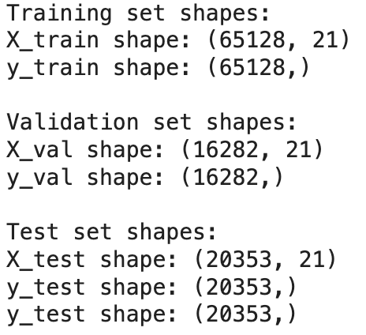
Training, Validation, and Test Dataset
Split our data into the training, validation, and test sets
Notes:
Our data is split into training, validation, and test sets, in a 65/15/20 ratio. This ensures our model not only learns effectively but also generalizes well to new data. The training set helps the model learn patterns, the validation set helps us fine-tune and prevent overfitting, and the separate test set offers an unbiased performance assessment.

Slide 18
Modeling - Data Preprocessing & Hyperparameter Tuning
Data Preprocessing:
Applied consistently to all models.
Includes steps like Normalization and PCA for dimensionality reduction.
Ensures data is optimized for learning, improving model efficiency and accuracy.
Hyperparameter Tuning:
A systematic approach to fine-tune each model.
Utilizes techniques like GridSearch to identify optimal settings.
Enhances model performance by tailoring parameters to specific dataset characteristics.
Purpose:
To ensure a fair and effective comparison of different models.
Streamlines the process, making it efficient and replicable.
Outcome:
Expect models to be better adapted to the dataset, leading to improved prediction capabilities.
Aims for a balanced trade-off between model complexity and performance.
Notes:
Data preprocessing and hyperparameter tuning are pivotal. Preprocessing, including Normalization and PCA, optimizes our data for learning, enhancing model efficiency and accuracy. For hyperparameter tuning, we employ methods like GridSearch to tailor each model to our dataset's unique characteristics, striking a balance between complexity and performance.
Next, my teammate Travis will talk about feature engineering using data augmentation and the rest of the part

Slide 19
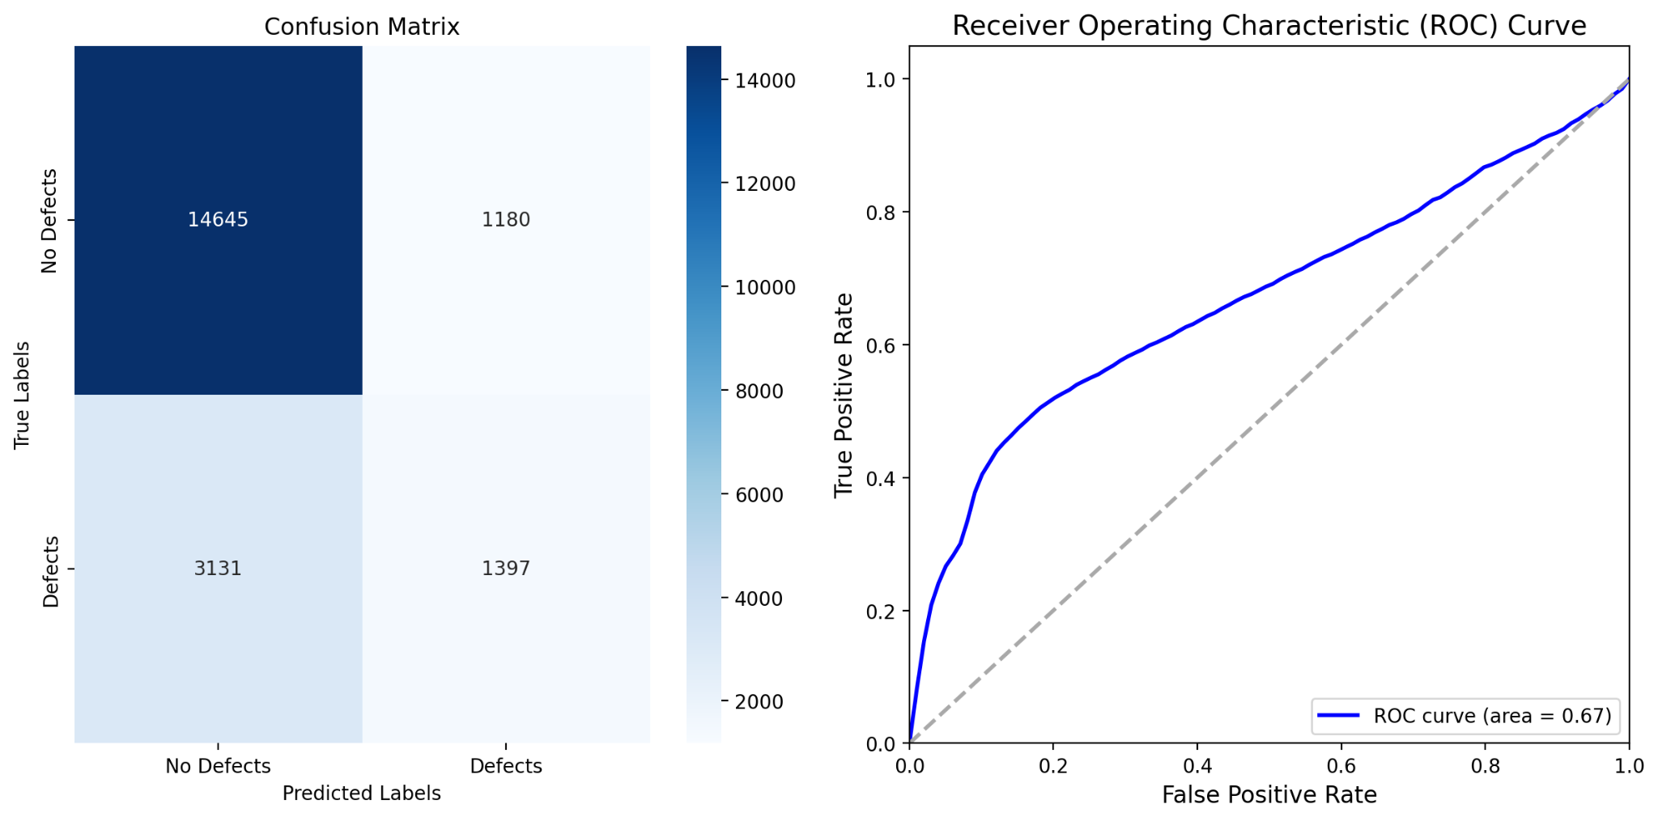
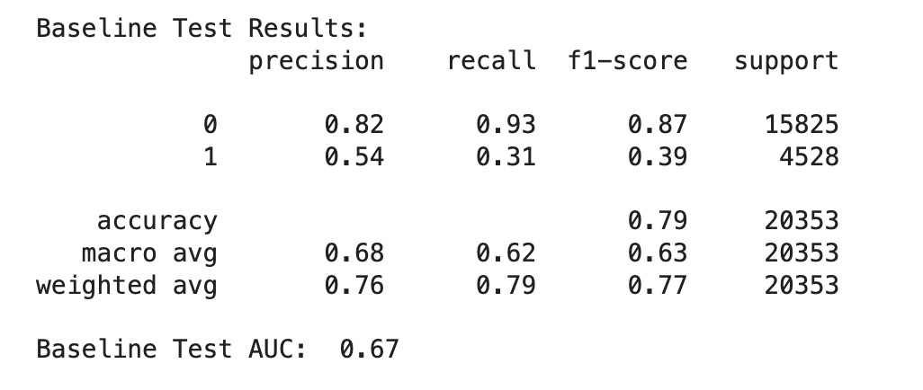
Modeling - BaseLine : Logistic Regression
Notes:
Based on the above evaluation metrics, we can see that our vanilla logistic regression model doesn't adequately fit to the data, although it is a decent prediction. The value of 0.67 for AUC means that there is a 67% chance that the model will be able to distinguish between positive class and negative class. Meanwhile, based on the value of weighted F1-score, we see that value of 0.77 is good in terms of prediction as the model is able to correctly predict more than half of the test samples. However, based on the confusion matrix as well as the precision, recall and macro f1-score for the positive labeled samples, we see that the model is doing very poorly on predicting the positive class. There are almost half of the positive samples is being misclassified as negative. As we previously mentioned, this is very detrimental in real-world situation, as we want our model to be more sensitive and responsive to this positive samples since they are defect programs. With that being said, we want to tune the vanilla logistic regression model to see if we can improve on these metrics, which will eventually make our model more capable.

Slide 20
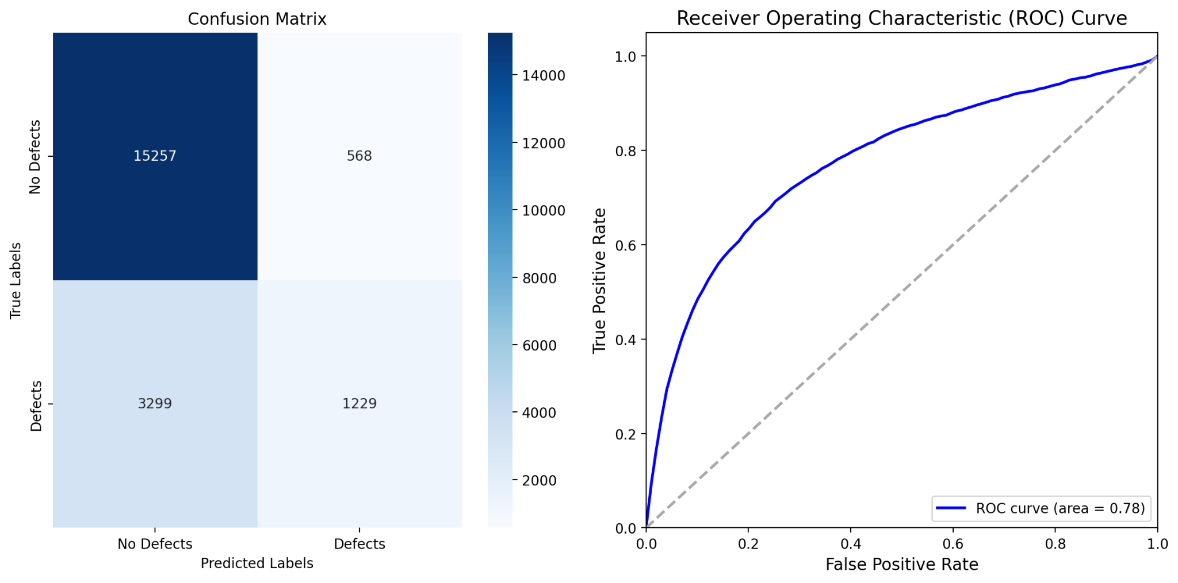
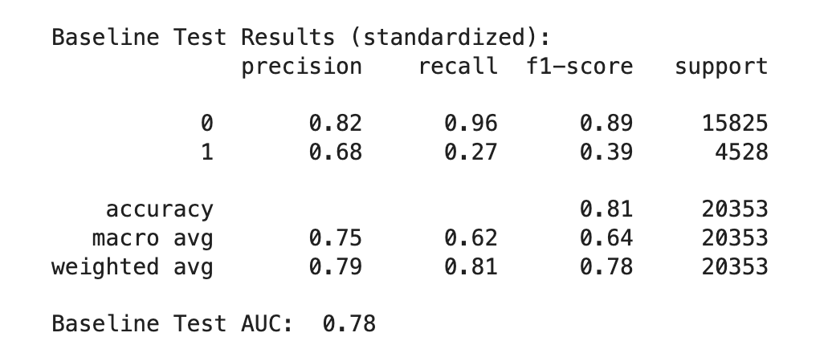
Modeling - BaseLine : Logistic Regression (Feature Scaled)
Notes:
Great! We see that the performance of our vanilla logistic regression was improved. The AUC value is now 0.78, which indicates that there are 78% chance that the model will be able to distinguish between positive class and negative class. Also, based on the confusion matrix, we see that the model is more capable of predicting positive samples as positive. However, the weighted F1 score does not improve promisingly, as we see the model is still misclassified some of samples with the labels in comparison to the ground truth label. Therefore, it is worth trying a hyperparemter tuning on the model to see if we could make the vanilla logistic regression performs even better!

Slide 21
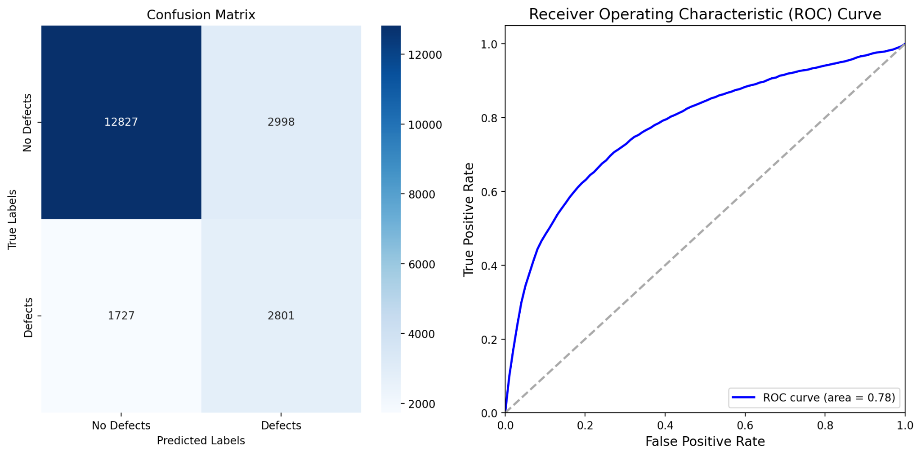
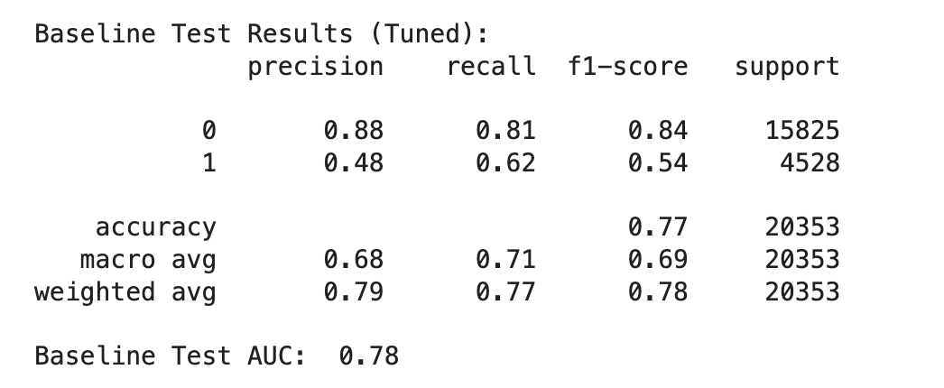
Modeling - BaseLine : Logistic Regression (Hyperparameter Tuned)
Grid Search Method:
Exhaustively tests combinations of hyperparameters.
Identifies the optimal settings for model performance.
Key Hyperparameters for Logistic Regression:
l1_ratio:
Controls the balance of L1 regularization.
Helps to manage multicollinearity and feature selection, improving model performance.
C (Inverse of Regularization Strength):
Determines the level of regularization.
Lower values mean stronger regularization, which can be crucial for model accuracy.
Data Preparation:
Uses normalized data to apply L1 and L2 regularization uniformly across all features.
Normalization also contributes to better model performance.
Objective: Fine-tune logistic regression to optimize performance, considering our dataset's specific characteristics.

Slide 22
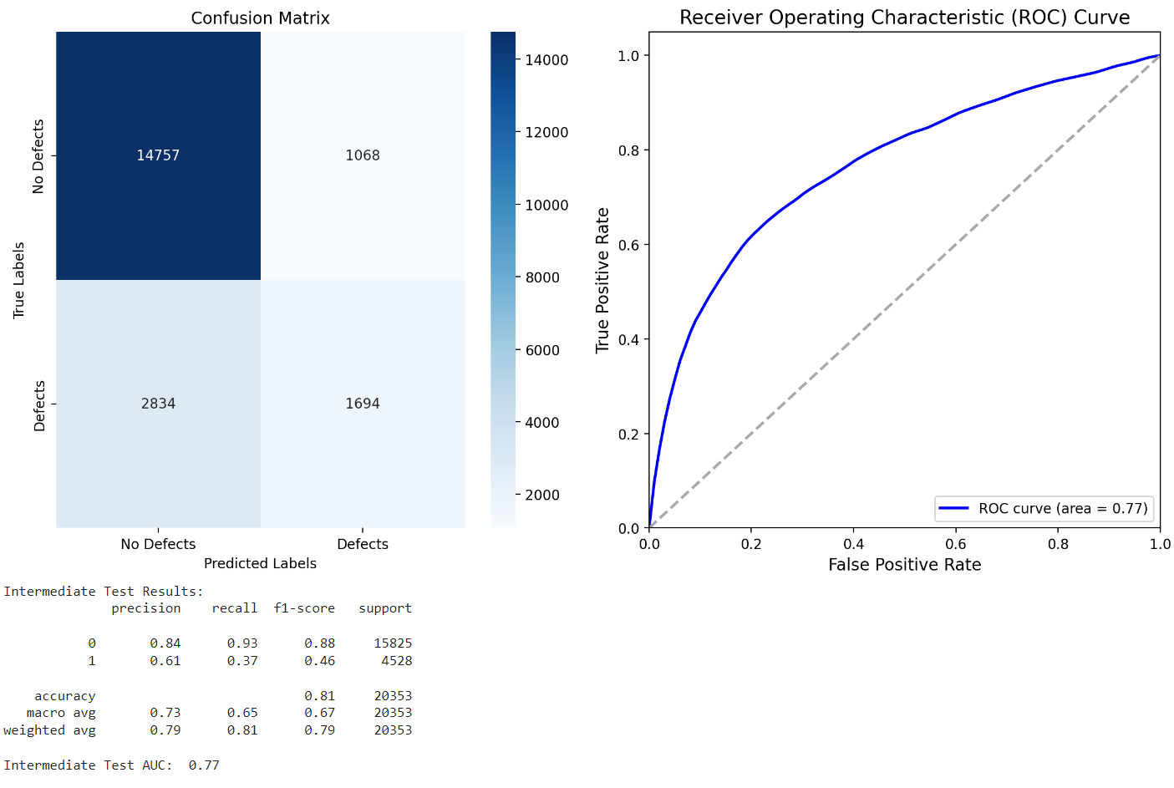
Modeling - Random Forest

Slide 23
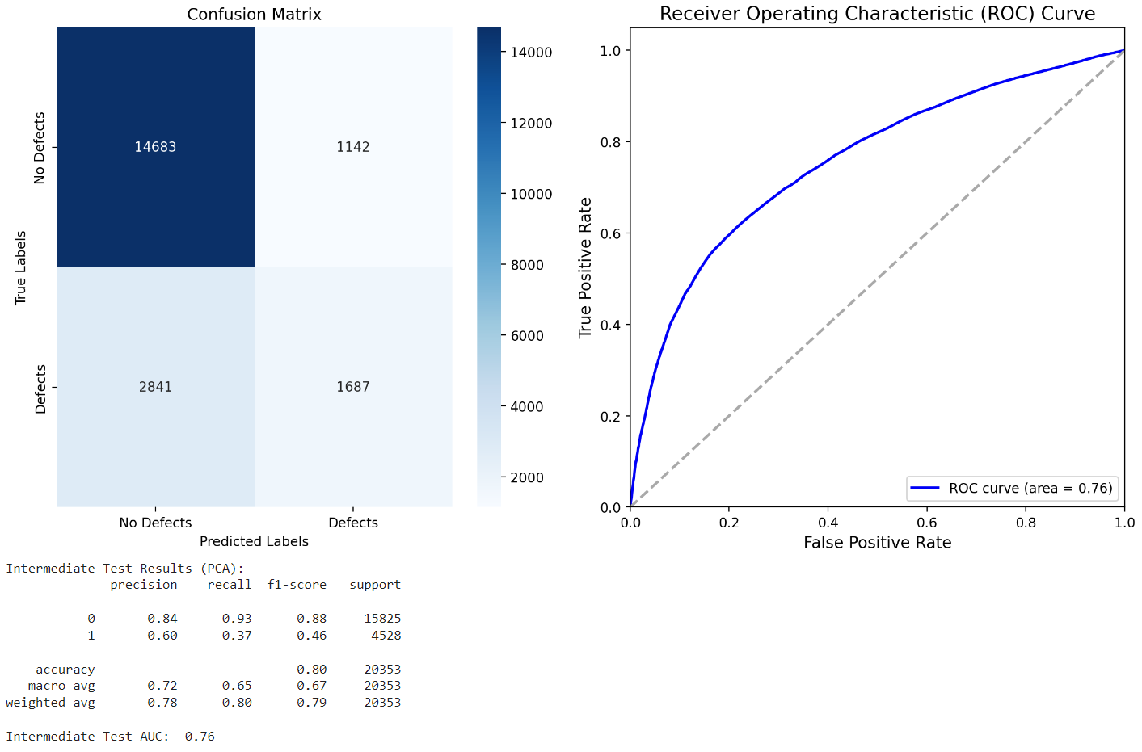
Modeling - Random Forest (PCA)

Slide 24

Modeling - Random Forest (Hyperparameter Tuned)

Slide 25
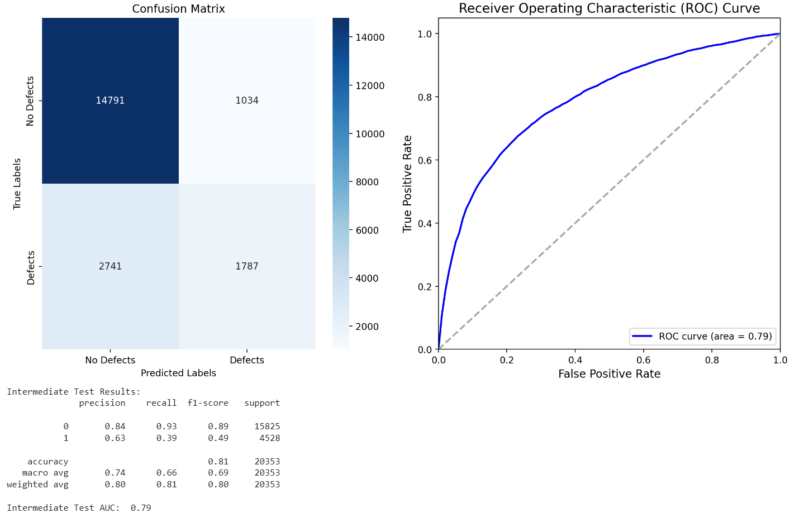
Modeling - Gradient Tree Boosting

Slide 26

Modeling - Gradient Tree Boosting (PCA)

Slide 27

Modeling - Gradient Tree Boosting (Hyperparameter Tuned)

Slide 28

Modeling - XGBoost

Slide 29

Modeling - XGBoost (PCA)

Slide 30

Modeling - XGBoost (Hyperparameter Tuned)

Slide 31
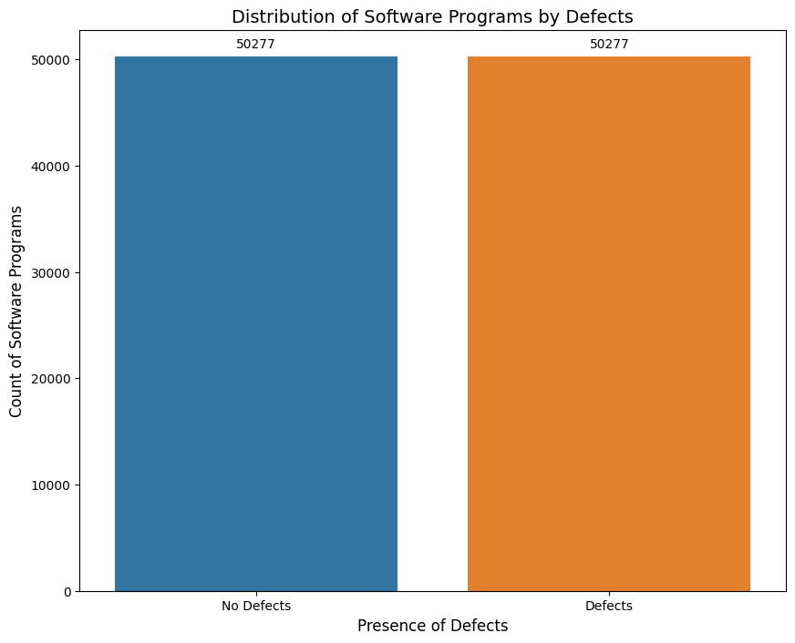
Modeling - Feature Engineering (Data Augmentation)
Issue: Imbalance in Target Variable
Our dataset shows a imbalanced distribution between 'True Defects' and 'False Defects'.
Solution: Data Augmentation with SMOTE (Synthetic Minority Over-sampling Technique)
What is SMOTE?: A technique to create synthetic (not real but realistic) samples of the minority class ('True Defects' in our case) to balance the dataset.
How it Works: Generates new instances by interpolating between existing minority instances.
Goal: Achieve a more balanced dataset which can lead to more accurate and fair model predictions.
Importance:
Balanced data helps prevent model bias towards the majority class.
Ensures both 'Defect' and 'No Defect' cases are equally represented and learned by the model.
Outcome Expectation:
A more robust model capable of detecting defects more reliably.

Slide 32
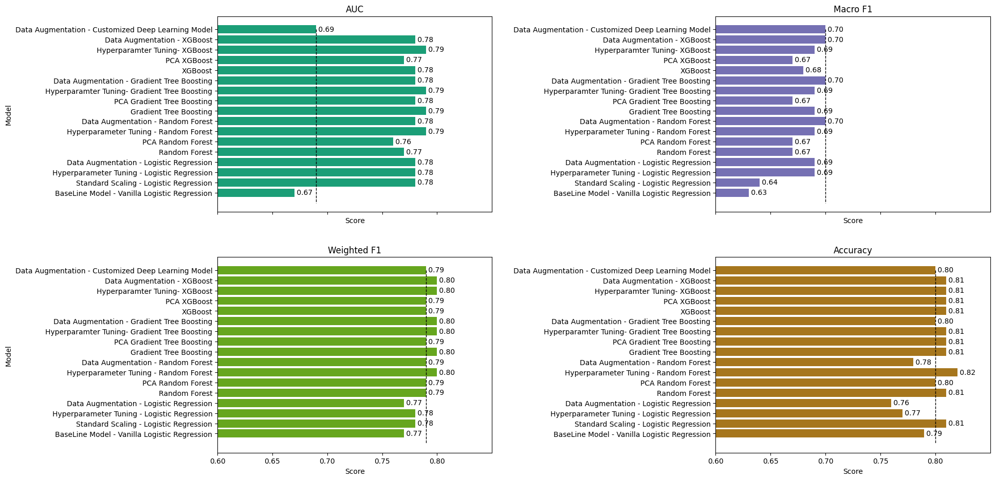
Modeling - Performance Comparison
Notes:
Let's take a look at how our models have performed after the preprocessing and optimization steps we implemented. In these comparison charts, we measure model performance using four different metrics: AUC, Macro F1, Weighted F1 and Accuracy.
Starting with the AUC, or Area Under the Curve, we observe that our customized deep learning model, after data augmentation, shows an AUC of 0.69. While this might not be the highest score among the models, it's a significant improvement from the baseline logistic regression model. The XGBoost and Gradient Tree Boosting models, especially with hyperparameter tuning and PCA, exhibit impressive AUC scores, all peaking at 0.79, indicating a strong ability to distinguish between defect and non-defect classes.
Moving on to the Macro F1 Score, which is particularly important in the context of our imbalanced dataset, we see a similar pattern. The models with data augmentation and hyperparameter tuning consistently outperform the baseline models. The deep learning model again shows a competitive score, tying with the majority at 0.70, reinforcing its capability to balance precision and recall.
Lastly, when we look at Accuracy, our models display a close range of results, from 0.79 to 0.82. It's important to note that while accuracy is less informative on its own due to class imbalance, it still provides a snapshot of overall performance. Our deep learning model reaches 0.80, which, when combined with its Macro F1 and AUC performance, confirms its robustness. Meanwhile, the PCA Random Forest and Gradient Tree Boosting models achieve the highest accuracy, both at 0.82.
In summary, while our customized deep learning model shows promising results, the traditional models, particularly with PCA and hyperparameter tuning, demonstrate strong performance across all metrics. This gives us a comprehensive understanding of where each model's strengths.

Slide 33
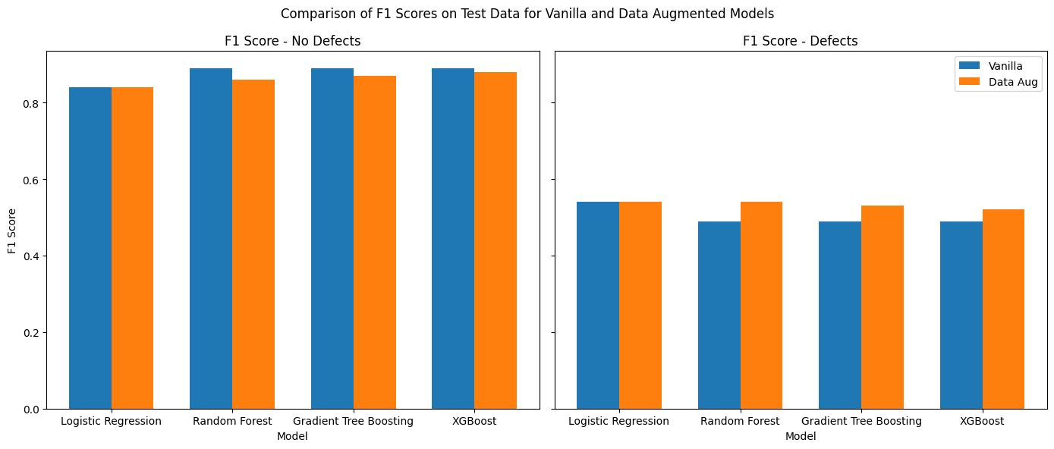
Impacts of Data Augmentation on Model Performance
Notes:
In assessing the effectiveness of our models, we've conducted a critical analysis on the influence of data augmentation. The chart presented here reveals the comparison of F1-scores for both vanilla and data-augmented models, across two dimensions: 'No Defects' and 'Defects'.
On the left, we have the F1-scores for 'No Defects'. We observe that the data-augmented models (shown in orange) maintain a comparable F1-score to the vanilla models (shown in blue) across Logistic Regression, Random Forest, Gradient Tree Boosting, and XGBoost. This suggests that data augmentation does not deteriorate the model's ability to correctly identify the absence of defects.
On the right, the F1-scores for 'Defects' tell a more nuanced story. Here, data augmentation appears to have a more pronounced effect. While the vanilla models exhibit certain performance levels, the augmented models in every case show an improved F1-score. This improvement is a testament to the effectiveness of data augmentation in addressing class imbalance, particularly by enhancing the model's sensitivity to the minority class – in our case, the defective samples.
In conclusion, data augmentation has bolstered our models' proficiency in defect detection, which is crucial for the predictive accuracy we strive for in this project. It's important to note that this improvement in detecting defects does not come at the cost of falsely identifying non-defects, thus maintaining a balanced predictive capability

Slide 34
Impacts of Data Augmentation on Model Performance
Observation:
Models show improved performance in classifying positive samples (defects) on the augmented dataset.
Performance decreases on the original dataset, particularly for the majority class (no defects).
Reasons for Change:
Augmentation adds more positive samples, enhancing the model's ability to identify defects.
This leads to a trade-off, with reduced accuracy on the original, unbalanced dataset.
Key Insight:
Augmentation helps models learn patterns associated with the minority class more effectively.
However, it's essential to balance this with the need for generalization to real-world data.
Conclusion:
While augmentation makes models more sensitive to positive samples (a goal achieved), it's crucial to consider how this aligns with real-world application.
Ongoing refinement is needed to ensure models are both accurate and applicable in practical scenarios.

Slide 35
Conclusion
Upon evaluating various models using a dataset geared towards predicting defects in C programs, we conclude that traditional machine learning models with hyperparameter tuning and PCA show superior performance in key metrics. Despite the advanced capabilities of our custom deep learning model, it has not achieved a leading position, especially in the AUC metric, which is crucial for predicting defect presence with high confidence—a feature vital for the intended use in Integrated Development Environments (IDEs).

Slide 36
Conclusion
Challenges
A significant challenge we face is the underwhelming AUC of the deep learning model. The synthetic nature of our dataset, which is derived from a model trained on data from 2004, might not capture the full complexity or feature set necessary for a deep learning model to excel.
Additionally, the potential non-linear and high-dimensional patterns characteristic of software defects might not be fully realized by the model in its current form.
Notes:
Upon evaluating various models using a dataset geared towards predicting defects in C programs, we conclude that traditional machine learning models with hyperparameter tuning and PCA show superior performance in key metrics. Despite the advanced capabilities of our custom deep learning model, it has not achieved a leading position, especially in the AUC metric, which is crucial for predicting defect presence with high confidence—a feature vital for the intended use in Integrated Development Environments (IDEs).

Slide 37
Conclusion
Future Works
We will delve deeper into the neural network's structure. We aim to enrich the model's learning context, potentially by incorporating additional real-world data or by synthesizing more complex features that could highlight the subtleties of defective versus non-defective code.
Furthermore, we intend to explore advanced data augmentation techniques that may better simulate the real-world variance in software defects. Cost-sensitive learning and other imbalance-targeting strategies will be evaluated to enhance the model's performance on minority classes, which are often the most critical to detect in a defect prediction context.

